Slide 1



Slide 2


Presented by
TEAM JABBERWOCKY
Date: 2nd December, 2015

Slide 3




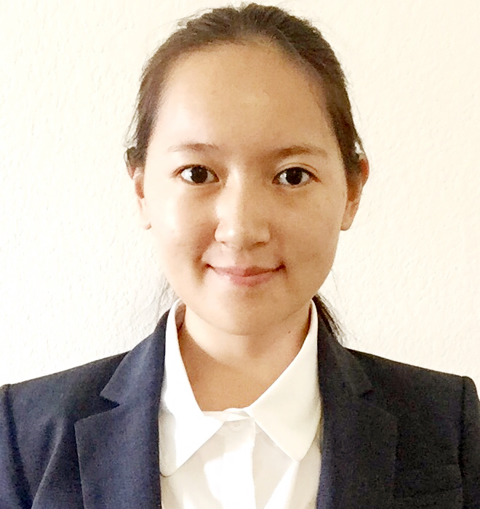

TEAM JABBERWOCKY
Lebreck Justin
Ziegler Joshua
Ziegler Michelle
HSU Johnny
Ma Taoran
Patil Sameer

Slide 4

Thank you Co.Host
Co.Host Team:
Dustin Cox
Adam Tank
Amelia Klawon

Slide 5
Agenda:
Client & Requirements
Conceptual Design (ER Diagram)
Sample queries and Triggers
Stored Procedures
Front End Demo
Conclusion and Next steps

Slide 6
Client & Requirements

Slide 7
Client Information:
Tucson Based start up: Airbnb of business travel
Provide a unique platform to connect employees to host colleagues traveling for business.
Value points:
Reduce business travel expenses
Improve employee engagement
Expect to start booking travel for their pilot customers within the next few months.
Need help to set up database infrastructure.

Slide 8
Requirements:
Login access to client (hosts and travellers) & admin team
Company and point of contact details
Each company location assigned to a region
Store house characteristics with amenities
Room reservation and discount
Reports to access business statistics

Slide 9
Conceptual Design (ER Diagram)

Slide 10
ER overview
Company Details
Employee Information
Reservation and Housing Details

Slide 11
ER Part 1:Employee Information

Slide 12
ER Part 2:Company Details

Slide 13
ER Part 3:Reservation

Slide 14
Queries, Procedures, and Triggers

Slide 15
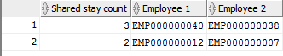
Sample Query
How often do employees stay together ?

Slide 16
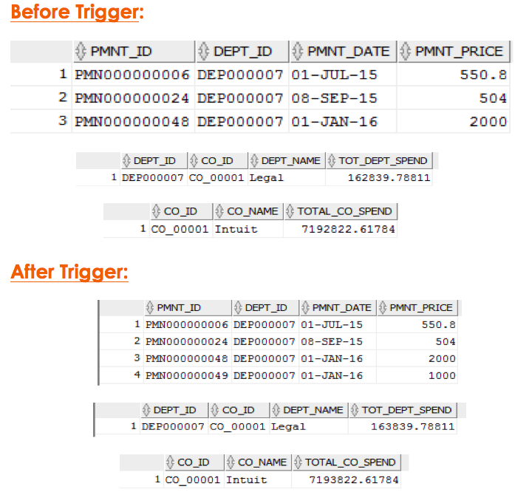
Triggers:
Event: Insert or Update Payment
Result: Update Total Spend- Company, Department
CREATE or REPLACE TRIGGER Trig_Dept_Company_Spend
BEFORE INSERT or UPDATE of pmnt_price on PAYMENT
For Each Row
IF (Inserting) THEN
…
temp_tot_dept_spend := temp_tot_dept_spend + : new.pmnt_price;
temp_tot_co_spend := temp_tot_co_spend + : new.pmnt_price;
IF (Updating) THEN
…
temp_tot_dept_spend := temp_tot_detp_spend - : old.pmnt_price;
temp_tot_detp_spend := temp_tot_detp_spend + : new.pmnt_price;
temp_tot_co_spend := temp_tot_co_spend - : old.pmnt_price;
temp_tot_co_spend := temp_tot_co_spend + : new.pmnt_price;
…
If Insert, update total spend
If update, update total spend

Slide 17
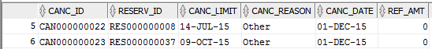
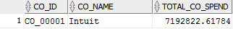
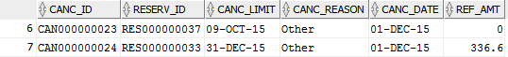
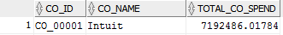
Triggers:
Event: Insert Cancellation
Result: Update Total Spend - Company, Department
CREATE or REPLACE TRIGGER Trig_Can_Seq
BEFORE INSERT ON CANCELLATION
…
temp_canc_limit := rserve_start - 1
IF ( sysdate <= temp_canc_limit) THEN
temp_ref_amnt : = pmnt_price
ELSE
temp_ref_amnt := 0;
END IF;
…
temp_tot_dept_spend := temp_tot_dept_spend - temp_ref_amt;;
temp_tot_co_spend := temp_tot_co_spend - temp_ref_amt;
Before Cancellation
Determine last date for cancellation
Decide to refund or not
After Cancellation
Update spend of company and department

Slide 18
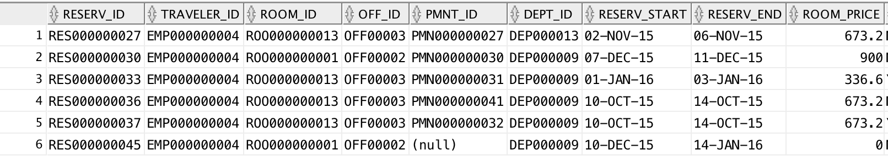
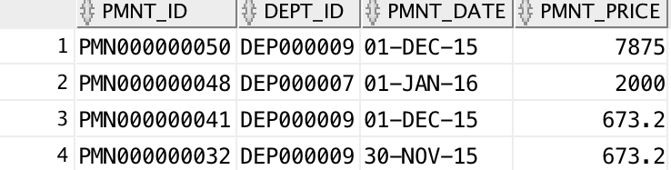
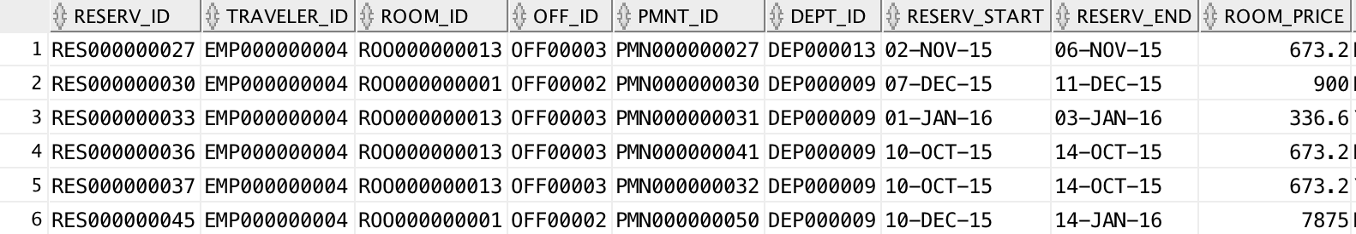
Procedure:
Execution: Make Payment
Result: total price for a room for a given period
Create or Replace Procedure Make_Payment ( reservation_ID …)
As …
While (temp_current_date < temp_end_date) Loop
Select region_rate Into temp_region_rate From REGION_RATE
Where …
And temp_current_date >= rate_begin_date
And temp_current_date <= (Add_Months(rate_begin_date ,1 ) -1);
temp_room_price := temp_region_rate * 0.9;
total_room_price := temp_room_price + total_room_price;
temp_current_date := temp_current_date +1;
End Loop;
While…Loop for calculation of total price for single reservation
Select region price based on date
Calculate the price

Slide 19
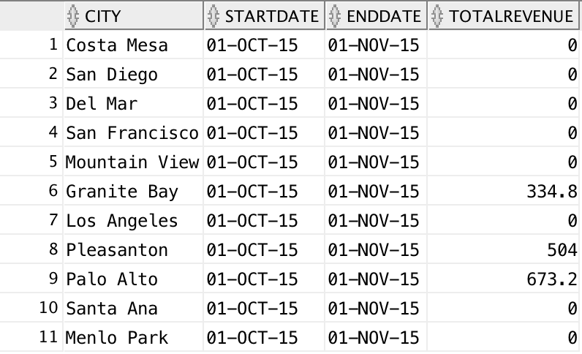
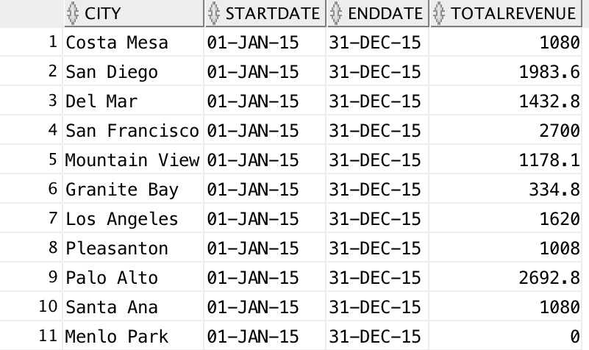
Procedure:
Execution: Create Financial Statement
Result: Revenues per city over given time periods
Create or Replace Procedure Revenue_For_Period
( start_date …, end_date…) AS
Cursor C1 is Select …. From ….
Where …And pmnt_date >= start_date and pmnt_date <= end_date ;
Cursor C2 is Select distinct addrs_city from ADDRESS;
For C2_row in C2 Loop
temp_revenue:= 0; total_revenue:=0; temp_city := C2_row.addrs_city;
For C1_row in C1 Loop
If (C1_row.addrs_city = temp_city) Then
temp_revenue := C1_row.pmnt_price ;
total_revenue := temp_revenue + total_revenue ;
End If;
End Loop;
Insert into REVENUE_PER_CITY (… ) Values (…)
End Loop;
1.Table Payment with cities
within period 2. Table with all cities
For every city
Calculate the revenue for the city
Insert the revenue for the city

Slide 20
Front End Demo
Co.Host

Slide 21
Conclusion:
Solution for CoHost
27 Relational tables
4 Triggers & procedures
10 Reports
124 Attributes
21 Entities

Slide 22
Thank you !

